Slide 1
Meta Clustering in cyt
New feature

Slide 2
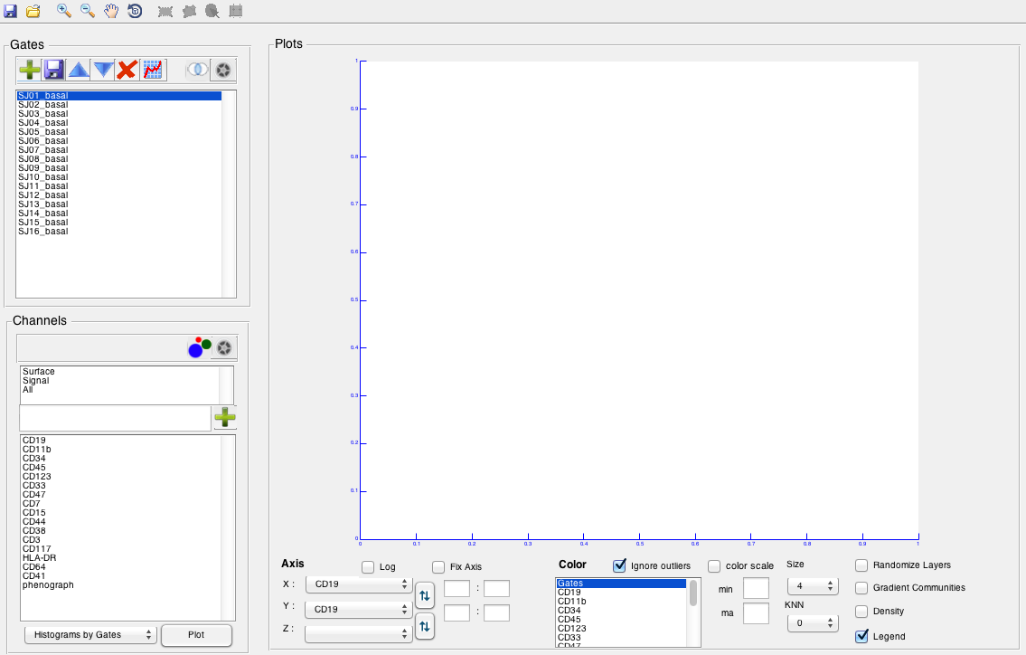
Importing Data
Step 1

Slide 3
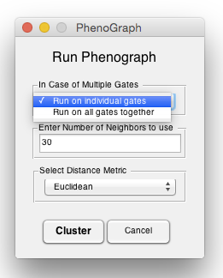
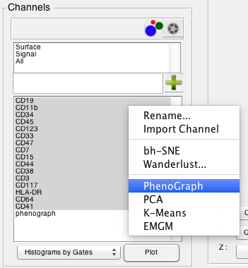
Running Cluster Method
Step 2
Choose the wanted Gates and Channels to cluster, right-click on the channels and choose ש clustering method. A new window will show up, choose to run it on individual gates or not, enter the wanted K and distance metric. A new cluster channel will show up.

Slide 4
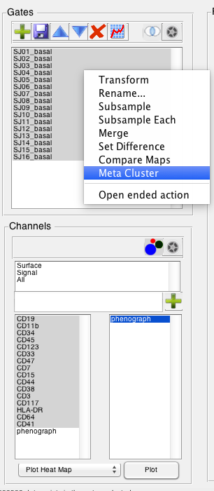
Cluster Mode in cyt
Step 3
Open Cluster Mode by clicking on the cluster button in the Channels panel.
A new panel will open with the list of cluster channels.
***You can work with clusters (Visualize, Create meta…) only in Cluster Mode.***

Slide 5
Running Meta Cluster Method
Step 4
Choose the wanted Gates and Channels to cluster, right-click on the channels and choose “Meta Cluster”.
A new window will show up, choose the method, wanted K and distance metric.

Slide 6
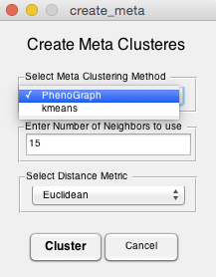
Running Meta Cluster Method
Step 5
In the the new window, choose a clustering method, K, distanc matric and press “cluster”.
A new meta cluster channel will show up in the cluster channel's’ list

Slide 7
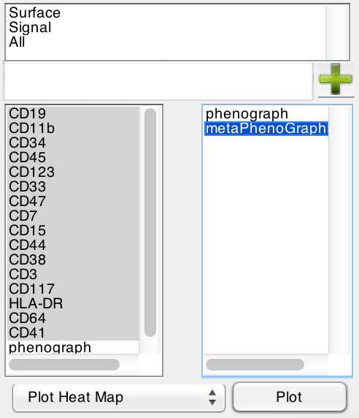
Visualize Clusters with Heat Map
Step 6
In the Cluster Mode, Choose the wanted Gates, Channels, and Cluster Channel.
Choose “Plot Cluster bh-SNE” in the combo box, and press the “Plot” button.

Slide 8
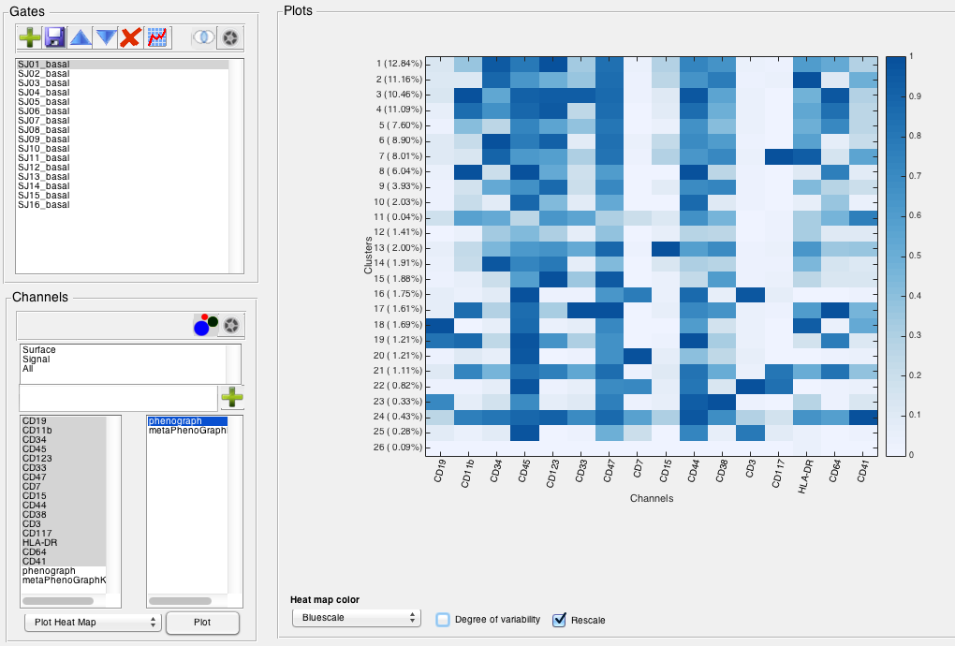
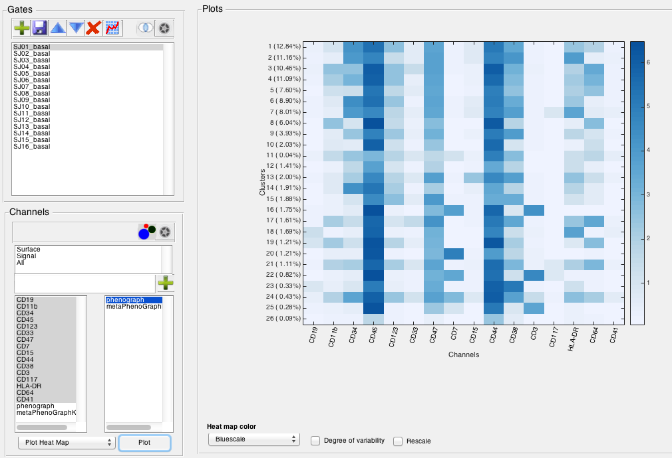
Visualize Clusters with Heat Map
Step 7
By choosing the “Rescale” you can normalize the data.
You can choose different color in the “Heat map color”.

Slide 9
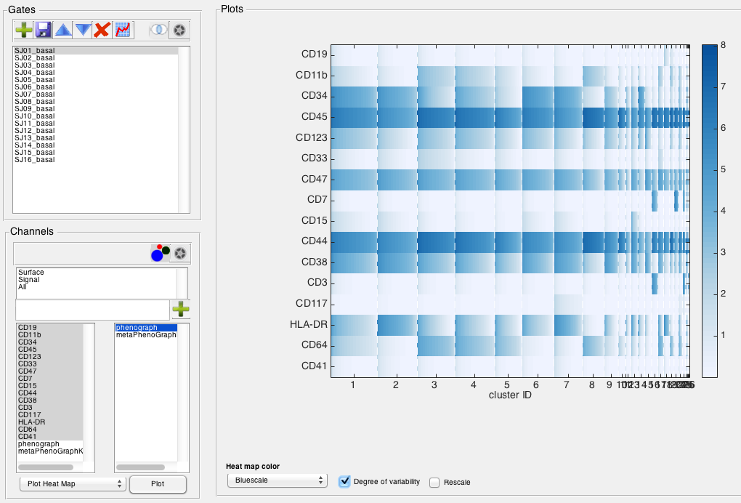
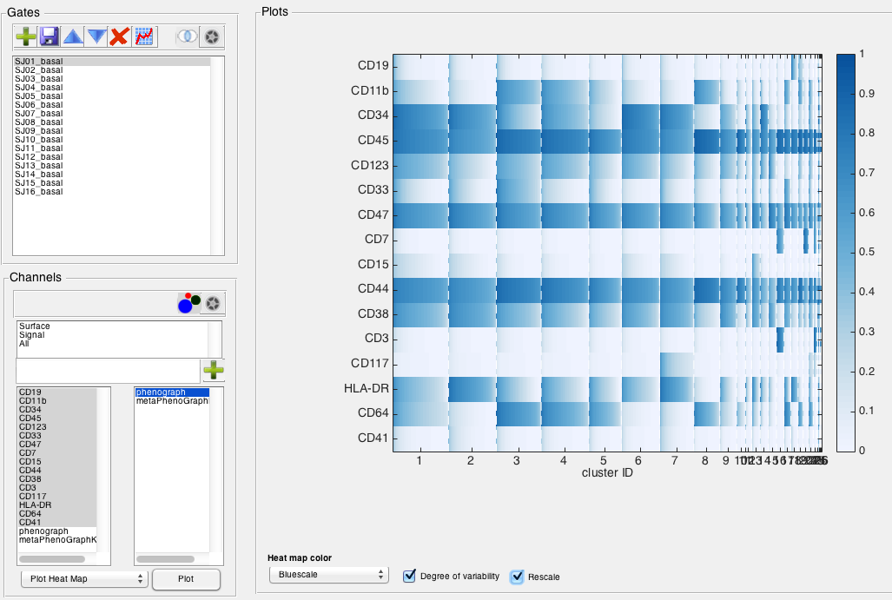
Visualize Clusters with Heat Map
Step 8
By choosing the “Degree of variability” you visualize the
channel distribution in each cluster.

Slide 10
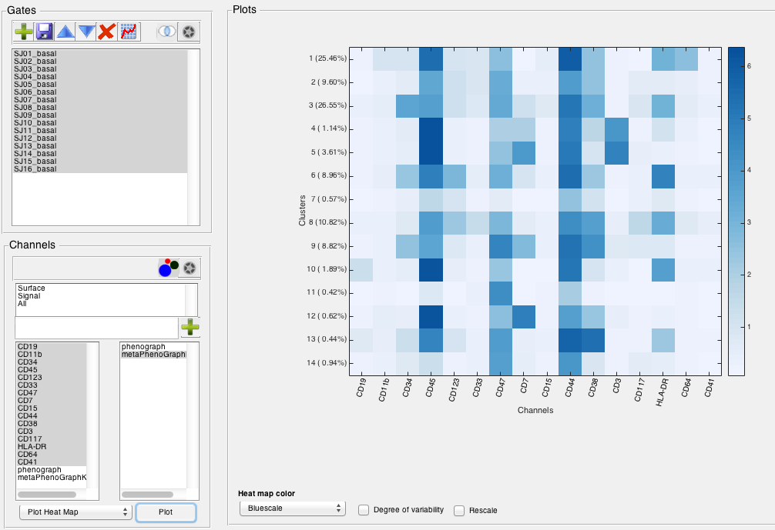
Visualize Clusters with Heat Map
Another example for Meta Cluster

Slide 11
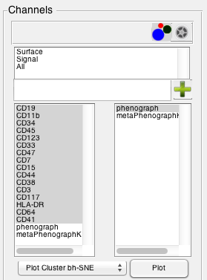
Visualize Clusters with bh-SNE
Step 9
In the Cluster Mode, Choose the wanted Gates, Channels, and Cluster Channel.
Choose “Plot Cluster bh-SNE” in the combo box, and press the “Plot” button.

Slide 12
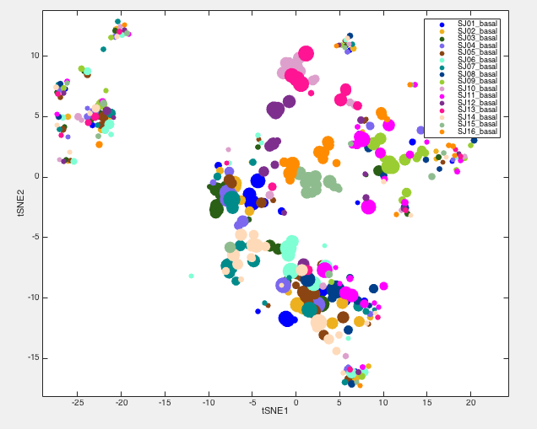
Visualize Clusters with bh-SNE
Step 10
In this plot, you can see the clusters, colored by gates.
The different sizes of the points are proportional to the population size.

Slide 13
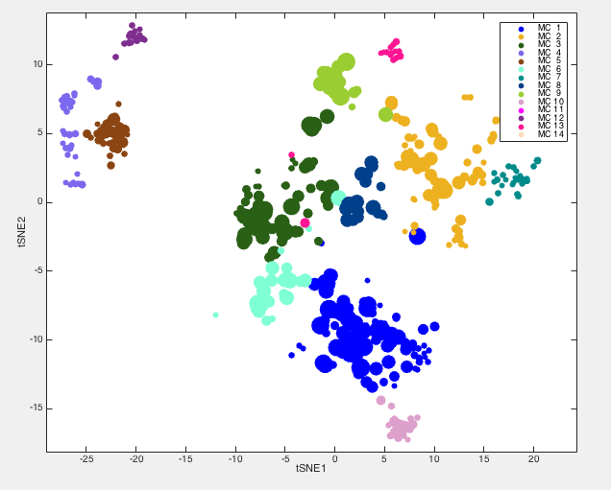
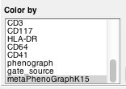
Visualize Clusters with bh-SNE
Step 11
By changing the “Color by” bar you can visualize the clusters colored by Meta Clusters.

Slide 14
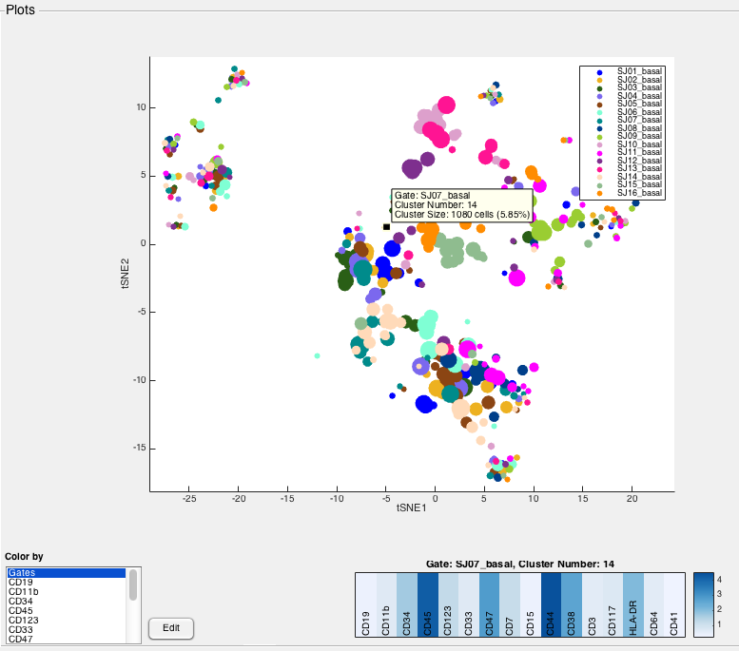
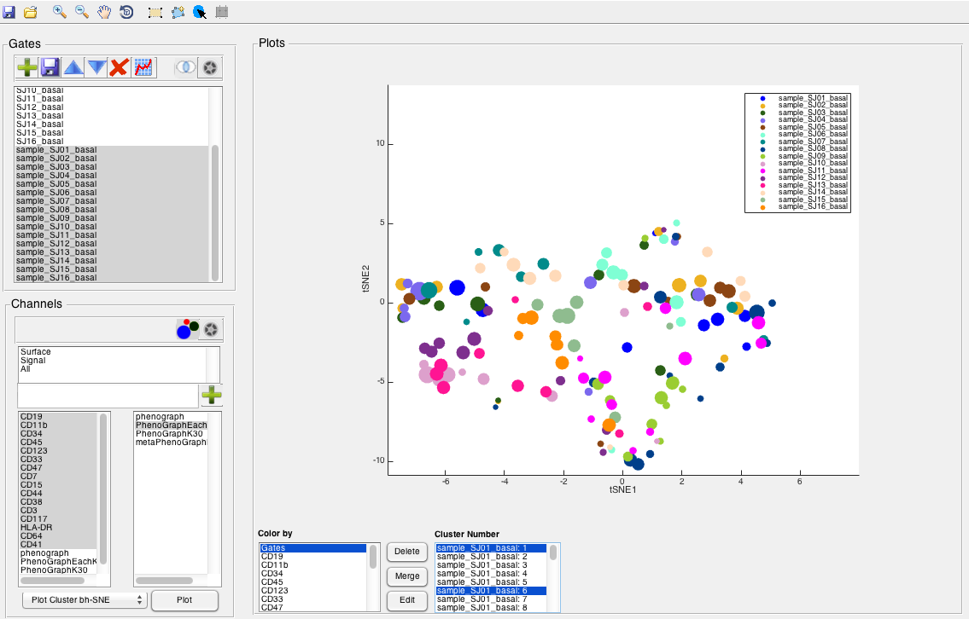
Specific Cluster in bh-SNE
Step 12
By clicking the “Select Cluster” button you can choose cluster in the plot by clicking
on them and an individual Heat Map will show in the right bottom.

Slide 15
Edit Clusters in bh-SNE
Step 13
Near the “Color by” bar there is a “Edit” button.
Click on the button if you like to delete or merge clusters.

Slide 16
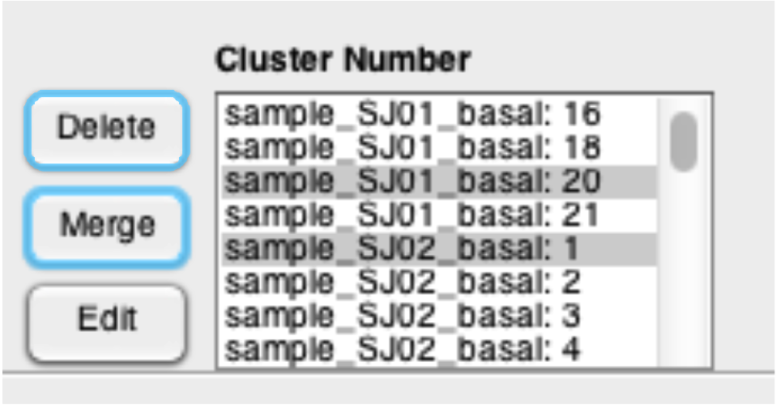
Edit Clusters in bh-SNE
Step 14
More features will show up in the editing mode.
Choose the clusters the you would like to edit and click on “Merge” or “Delete”.
A new channel will show up in the cluster channel’s list with the changes.

Slide 17
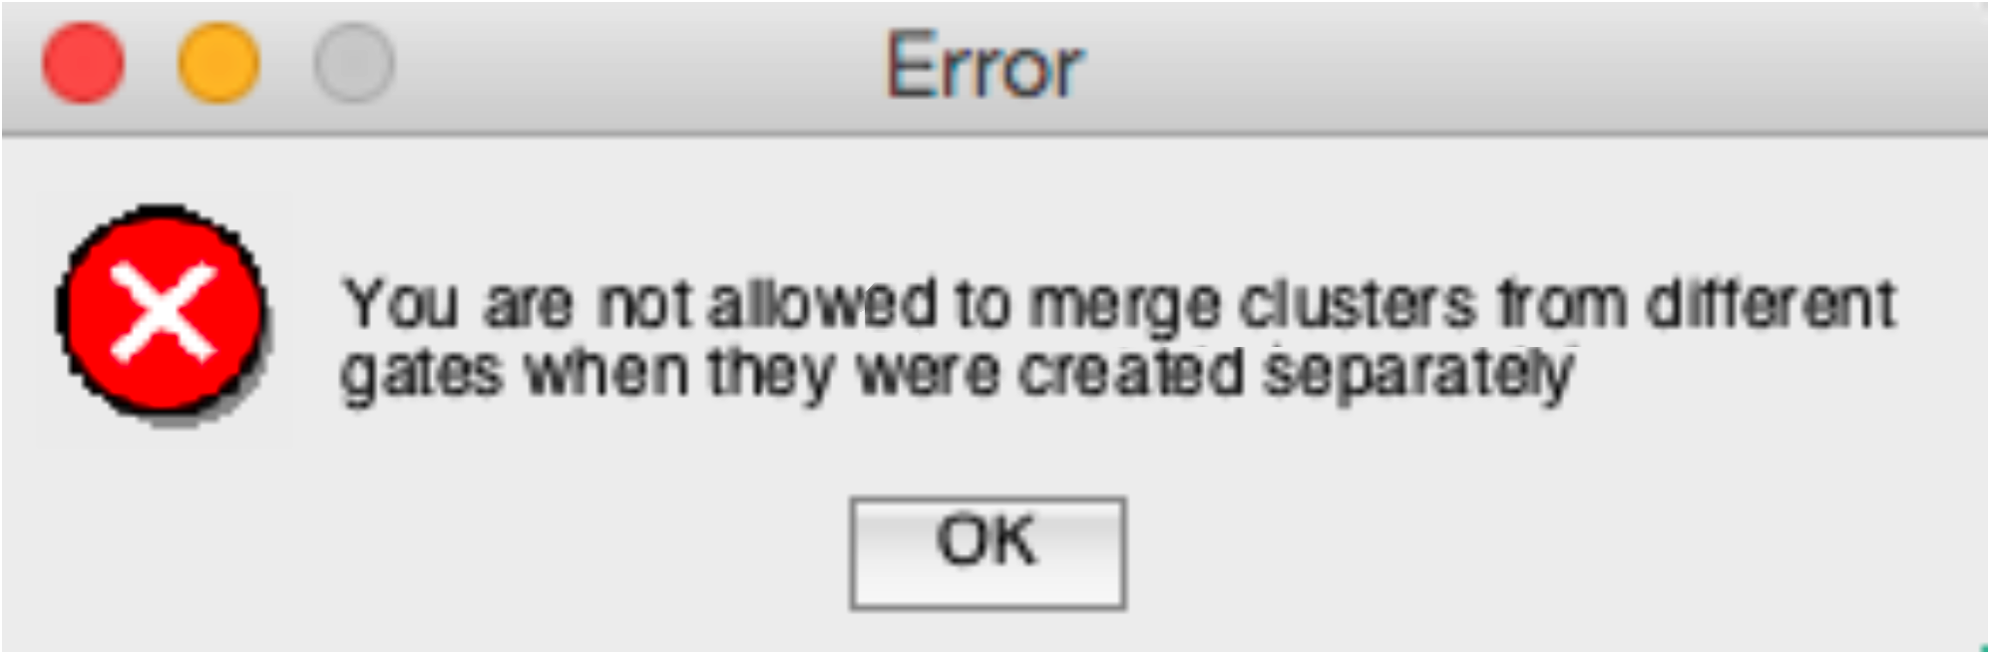
Edit Clusters in bh-SNE
***In case you are trying to merge different clusters from different gates,
when the clustering was on individual gates you will get this Error.***

